Slide 1
.Net Programming
Ngo Lam Trung
School of Information and Communication Technology
Office: 505-B1
E-mail: trungnl@soict.hust.edu.vn

Slide 2
Unit 8: Object lifetime

Slide 3
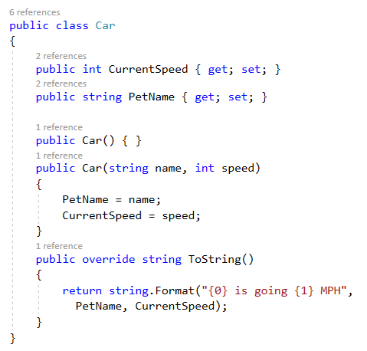
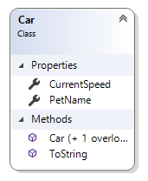
Classes, object, reference
Class: definition of an object type, how it “looks and feel” in memory
Class in c#: defined in a *.cs file

Slide 4
Classes, object, reference
Object: an instance of a class
Real thing, with real value
Occupy some area in heap
Reference:
Pointer to object
Usually local variables, stored in stack

Slide 5
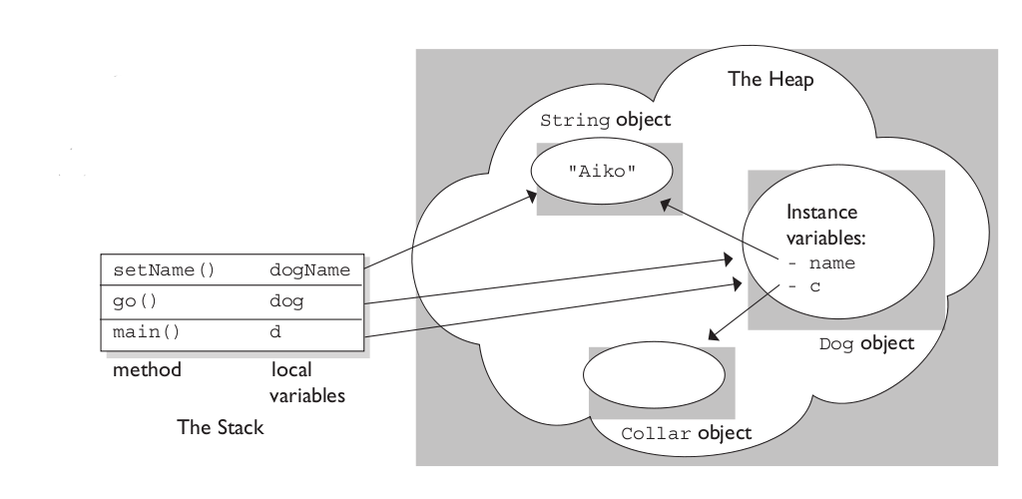
Classes, objects, references
Photo: stackoverflow.com

Slide 6
Object allocation in heap
Heap is the space for dynamic allocation
Object allocation: when new object is created (class instantiation).
Object deallocation: when object is deleted from memory (release memory)
Allocation: find an area in the heap that fits the object, return address to the reference

Slide 7
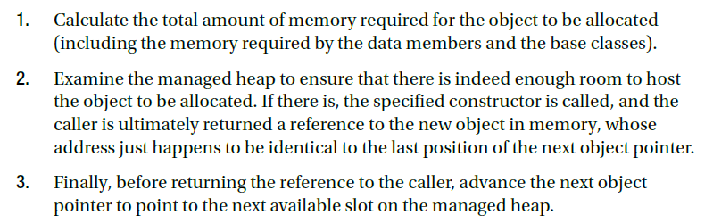
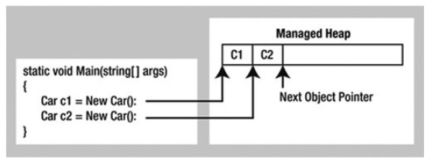
Object allocation in heap

Slide 8
Object lifetime
Problem:
Heap size is limited
Object allocation occurs continuously
➔ memory clean-up is required
Garbage collection (GC)
Garbage: objects that are no longer in-use
Collection: re-use garbage’s mem for new objects

Slide 9
How GC works?
When GC happens?
Which object will be removed?
How to remove garbage?

Slide 10
How GC works?
GC happens
When heap is “full”, new object cannot be allocated
Which object will be removed?
Objects that have 0 rooted reference
How to remove garbage?
Mark the mem as free, defragment if necessary

Slide 11
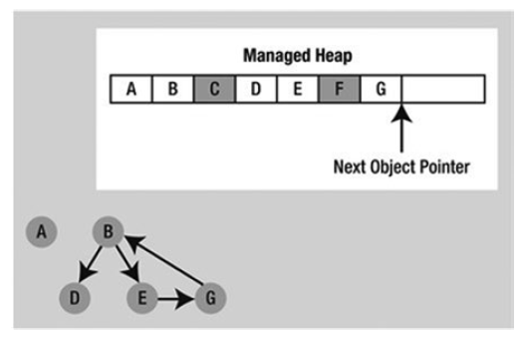
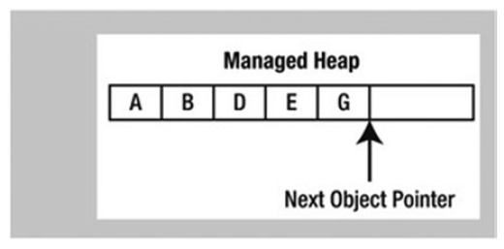
How GC works
Object graph is built from application root
Objects not found in the graph will be terminated
Heap will be compacted (defragmented)

Slide 12
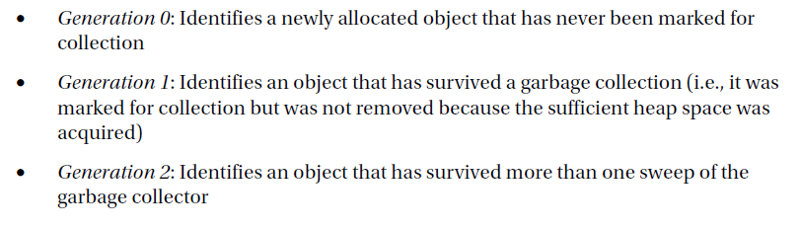
Object Generations
GC defines 3 object groups (generation)
GC process Gen 0 first, if memory is not sufficient, then proceed with Gen 1, then Gen 2…

Slide 13
Object generations
Object that survive a GC will be promoted to next generation
Higher generation will be more expensive to collect

Slide 14
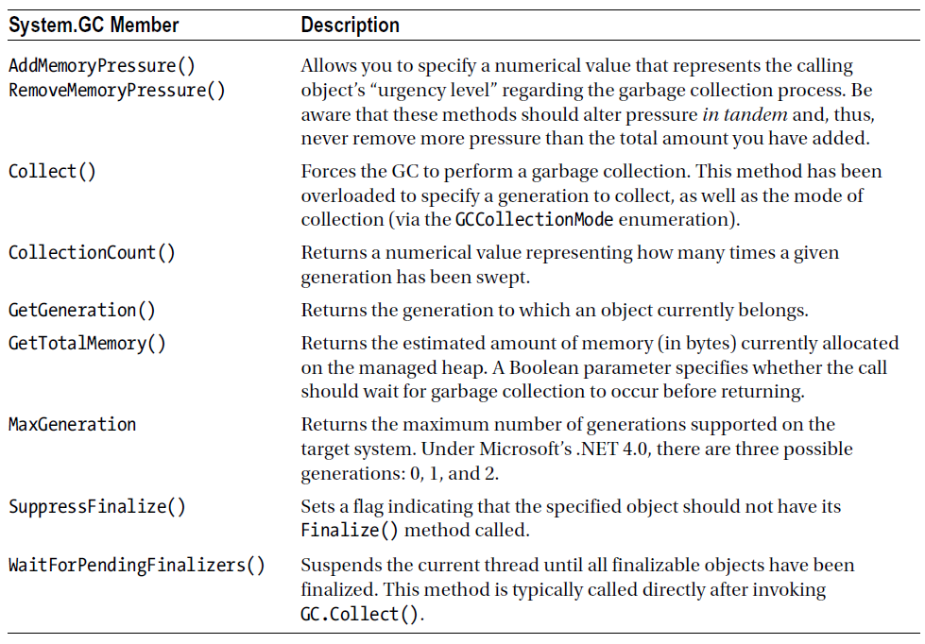
System.Gc

Slide 15
Sample 1

Slide 16

Forcing collection
Activate GC manually
GCCollectionMode.Forced: force GC to collect immediately.
Is this good or bad?

Slide 17
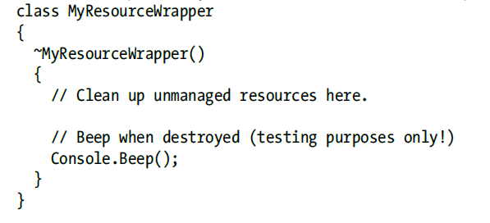
Finalizable object
Objects that will call a special function before removal from memory
Implemented as destructor

Slide 18
Finalizable object
Is this good or bad?

Slide 19
Disposable object
Objects that can dispose the resource they used after finish that use.
Compare to finalizable object: disposable object may invoke the Dispose function right after using the resource.

Slide 20
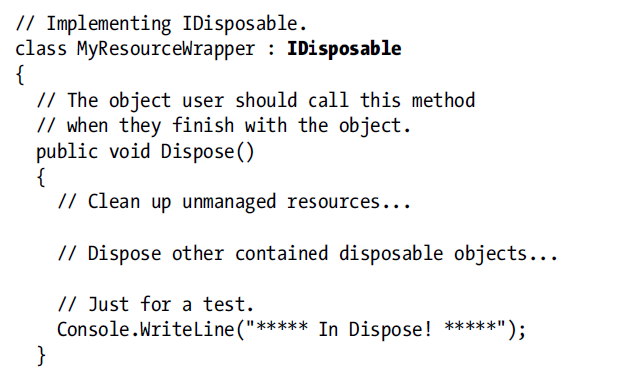
Disposable object

